Slide 1
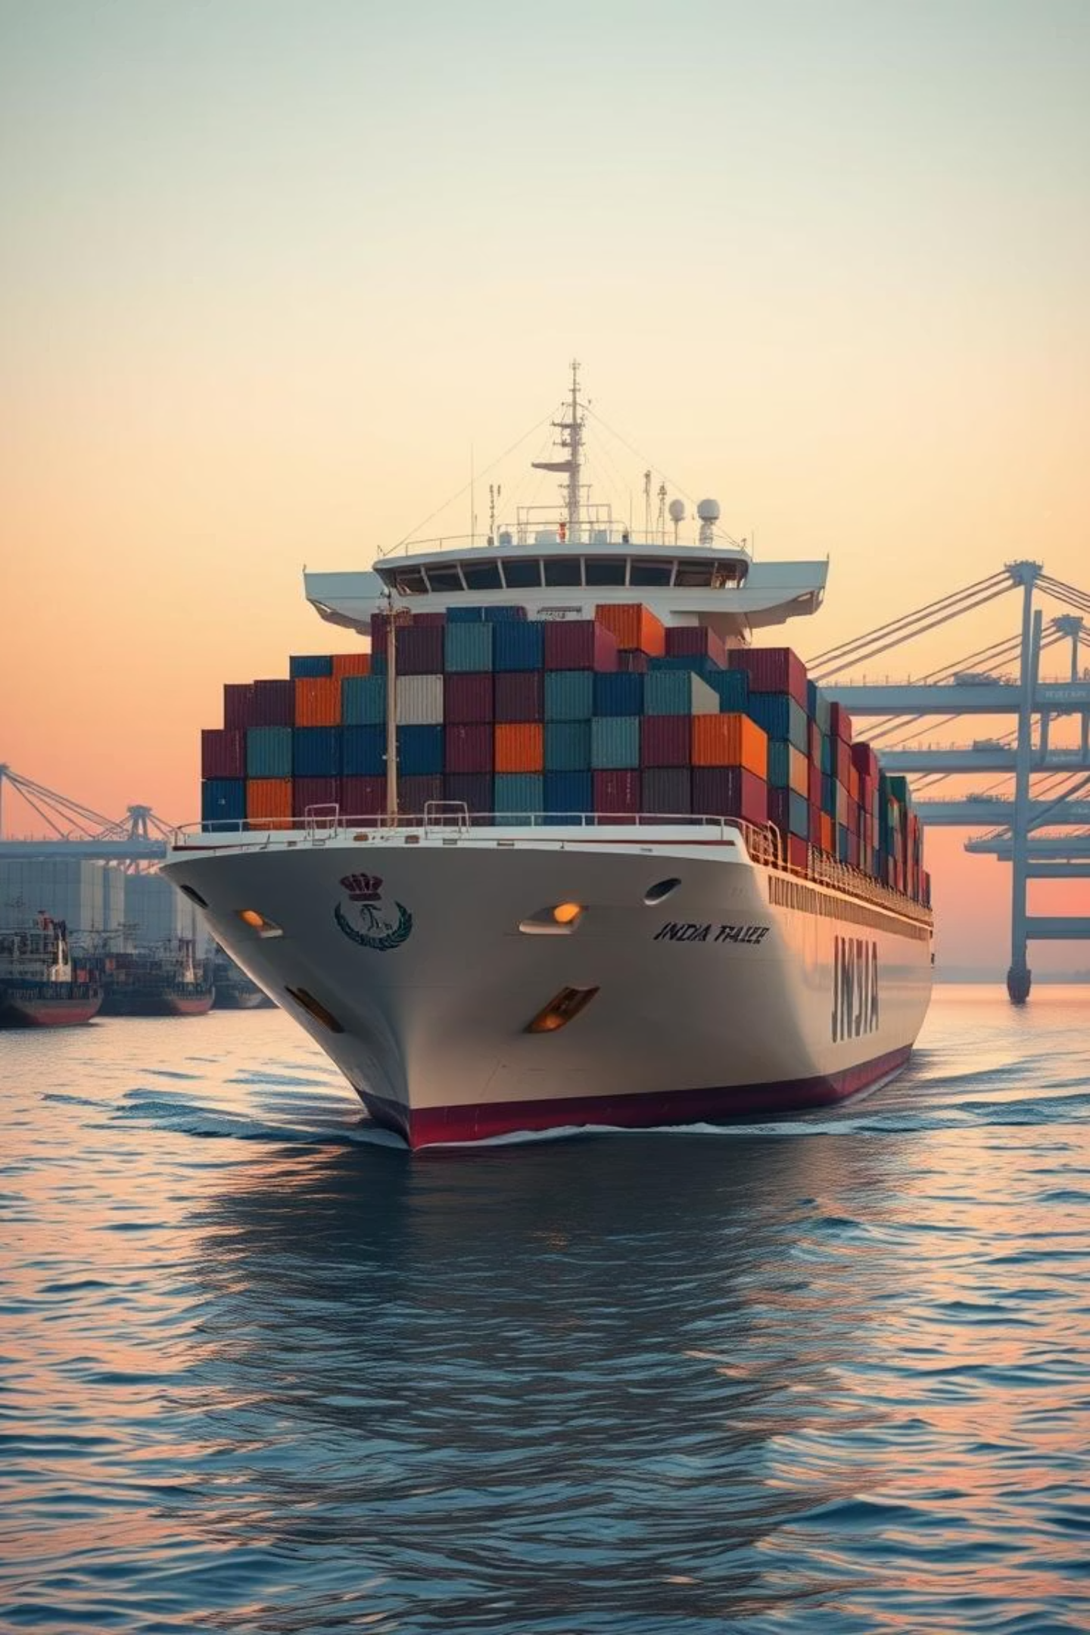
India's Trade Dynamics: 2015-2022
Navigating Global Shifts and Future Opportunities

Slide 2
Export Growth Trajectory
2015-2019
2021-2022
Steady growth across sectors.
Strong post-COVID rebound, record highs.
1
2
3
2020
Pandemic dip due to global disruptions.
India's exports have shown remarkable resilience and growth, particularly after the initial impact of the pandemic, driven by evolving global demand.

Slide 3

Key Trading Partners & Balances (2022)
Top Importers (2022)
Trade Balance Insights
World
Maximum Surplus: China
EU
Maximum Deficit: United States
WTO Members
Understanding these balances is crucial for strategic trade policy and economic stability.

Slide 4




Commodity Focus: Exports & Strategy
Top 2022 Export Commodities
Strategic Sector Development
1
Manufacturers
Promote High-Value Sectors
Capitalize on existing demand (e.g., Chemicals, Pharmaceuticals).
2
Machinery & Transport Equipment
Protect & Nurture Emerging Sectors
Safeguard agriculture, automotive, textiles for future growth and domestic needs.
Fuels & Mining Products
These sectors demonstrate India's competitive advantage and global demand.

Slide 5
Moving Forward: Policy & Potential
India's trade policy must strategically balance growth in established sectors with nurturing emerging industries to ensure sustainable and inclusive economic development.

